Slide 1


Department of Electronics & Communication Engineering
Project Work Phase2 (22ECP183)
AXI4 ASYNCHRONOUS FIFO: DESIN AND VERIFICATION USING UVM
Batch No: A16
Bhavana G H (1BG22EC020)
Manjunath C Shekar (1BG22EC051)
Suhani S Basti (1BG22EC124)
Guide: Dr.Smitha Gayathri D
Associate Professor, BNMIT

Slide 2
INTRODUCTION
Design and verify an AXI asynchronous FIFO to enable reliable data transfer across independent clock domains
Implement CDC synchronization, FIFO buffering, and interrupt handling to support high-throughput, low-latency communication
Phase-1 focused on validating the core asynchronous FIFO functionality at the DUT level.
Phase-2 verifying the DUT using a UVM-based testbench with a set of testcases focusing on back-to-back AXI transactions and FIFO boundary conditions such as full and empty states.
Focusing on stress and corner-case verification to improve coverage and ensure readiness for high-speed SoC integration

Slide 3
MOTIVATION
Modern SoC designs frequently operate with multiple clock domains, making reliable data transfer across asynchronous boundaries a critical challenge.
AXI4-Lite is widely used for control and low-bandwidth communication, requiring robust FIFO-based buffering to handle clock domain differences safely.
Verification of asynchronous designs is complex, adopting a UVM-based methodology improves reusability, scalability, and confidence in functional correctness.
Ensuring correct FIFO boundary behavior and back-to-back transactions is essential to prevent data loss, protocol violations, and system-level failures.

Slide 4
OBJECTIVES
Design a parameterized AXI4-Lite asynchronous FIFO to enable reliable data transfer across multiple clock domains while maintaining AXI4-Lite protocol compliance.
Implement and verify interrupt support in the DUT to notify the processor on FIFO events such as full, empty, and data availability.
Extend the design to include a configurable FIFO, allowing programmable depth and threshold levels for flexible SoC integration.
Develop a UVM-based verification environment using directed and constrained-random test scenarios across different clock ratios and backpressure conditions.
Validate the design using assertion-based verification and functional coverage, ensuring data integrity, correct interrupt behavior, and no protocol violations.

Slide 5
Literature Survey
Title of paper | Authors | Name of Journal/ conference | Publication Year | Main Findings | Points for future scope from the paper (if any)
A Study of Advances in Asynchronous FIFO Design | Multiple authors (ResearchGate publication) | ResearchGate / Journal preprint | 2025 | Presents recent improvements in asynchronous FIFO architectures, focusing on Gray code pointer synchronization, metastability mitigation, and efficient full/empty detection techniques. | Suggests exploring low-power FIFO designs and integrating formal verification techniques for CDC validation.
Application of Asynchronous FIFO in High-Speed Interface Data Transmission | Y. Zhang et al. | International Conference on Mechanical, Electrical and Electronics Engineering (ICMEEE) | 2024 | Demonstrates the effectiveness of asynchronous FIFOs in high-speed data interfaces, emphasizing reduced data loss and improved reliability across clock domains. | Recommends extending the design to AXI-based interfaces and validating under burst and stress traffic conditions.

Slide 6
Title of paper | Authors | Name of Journal/ conference | Publication Year | Main Findings | Points for future scope from the paper (if any)
Optimization of Asynchronous FIFO Design Difficulties Using Verilog HDL | L. Wang, H. Chen | Journal of Hardware and Embedded Systems Technology | 2024 | Analyzes common design challenges in asynchronous FIFOs and proposes Verilog-based solutions for synchronization and flag generation with simulation validation. | Future work includes improving scalability and applying coverage-driven verification methodologies.
Design and Implementation of Asynchronous FIFO | R. Kumar, S. Patel | International Journal of VLSI Design and Communication Systems | 2024 | Describes RTL-level design and implementation of an asynchronous FIFO, highlighting CDC synchronization and reliability under different clock ratios. | Suggests integrating the FIFO with standard bus protocols such as AXI and performing advanced verification.
Coverage Driven Verification of FIFO Using UVM | A. Sharma, P. Verma | STM Journals – International Journal of Electronics & Communication | 2023 | Demonstrates UVM-based verification of FIFO designs using constrained-random testing and functional coverage to detect corner-case bugs. | Proposes extending the approach to asynchronous FIFOs and adding stress and back-to-back transaction testcases.

Slide 7
Software Requirements
SystemVerilog + UVM 1.1d: Used to develop the RTL design and implement a structured, reusable UVM-based verification environment with constrained-random testing, functional coverage, and scoreboard checking.
QuestaSim (v10.7c or later): Used for compiling, simulating, and debugging the AXI asynchronous FIFO design and UVM testbench, including waveform analysis and protocol-level verification.

Slide 8
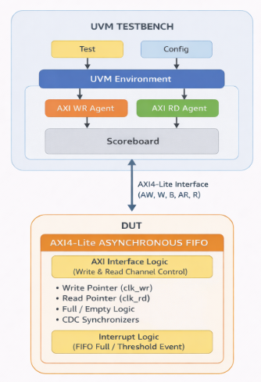
BLOCK DIAGRAM
Fig 1: Block Diagram of AXI4 Lite Assynchronous FIFO

Slide 9
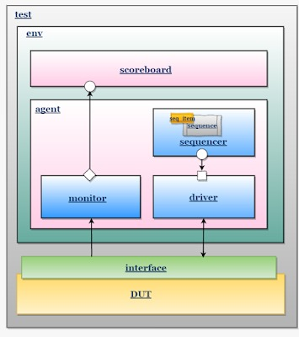
UVM
UVM provides a modular and reusable testbench architecture, separating verification components from the DUT.
Stimulus is generated using sequences and sequence items, which are converted to pin-level signals by the driver.
Monitors observe DUT behavior and send transactions to the scoreboard for correctness checking.
Scoreboard and assertions ensure functional correctness, protocol compliance, and data integrity.
Fig 3: UVM Architechture

Slide 10
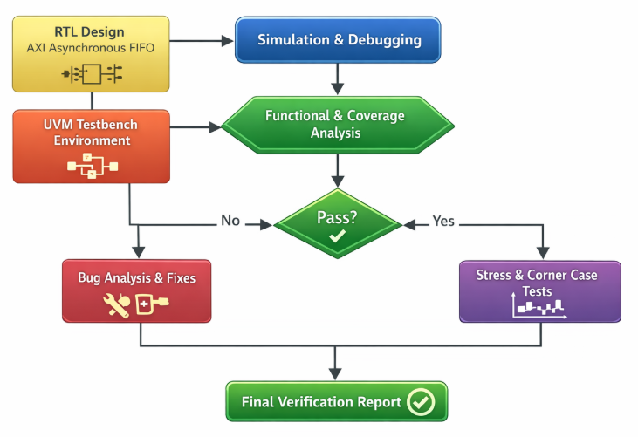
FLOWCHART
RTL design and UVM testbench are compiled and simulated to verify basic functionality.
Functional correctness is checked using sequences, driver, monitor, and scoreboard, with debugging if failures occur.
Stress and corner-case scenarios are applied to ensure robustness and protocol compliance, followed by generation of the verification report.
Fig 2 : Flowchart of UVM

Slide 11
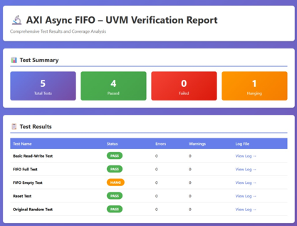
Fig 5: UVM Report

Slide 12
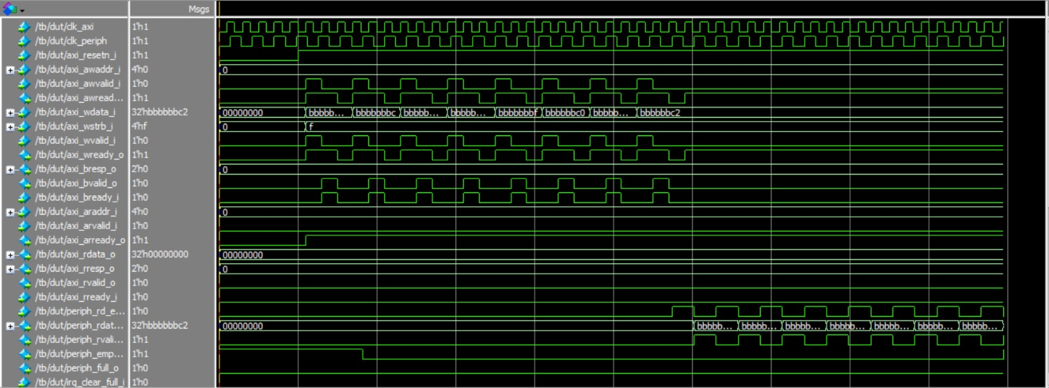
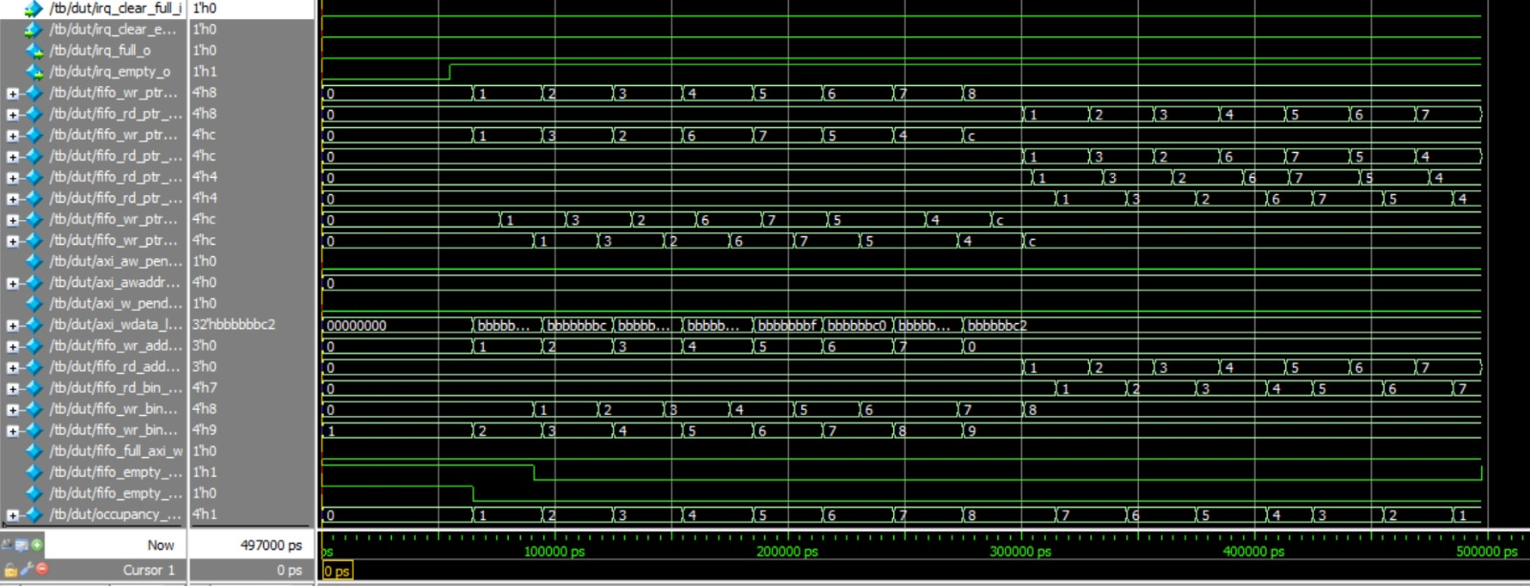
RESULTS
Fig 4: Waveforms

Slide 13
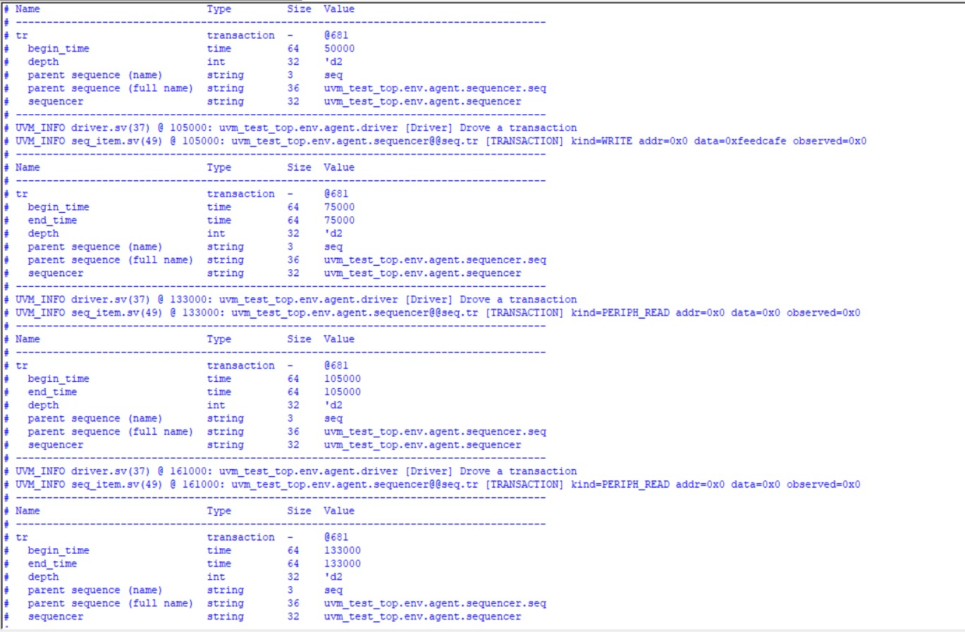
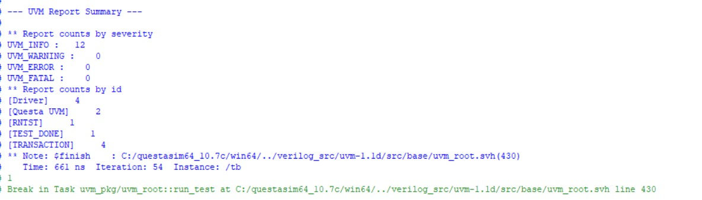
Fig 6: Transcript Logs

Slide 14
The waveform confirms correct AXI4-Lite read and write transactions with proper VALID–READY handshaking.
FIFO write and read pointers increment correctly, demonstrating reliable data buffering across operations.
Gray-coded pointers are used internally, ensuring safe pointer synchronization and preventing metastability.
FIFO full and empty flags assert and deassert at the correct times, avoiding overflow and underflow.
Data written through the AXI interface is accurately read back, proving data integrity.
Interrupt signals trigger correctly based on FIFO status conditions.
Overall results validate the functional correctness and robustness of the AXI4-Lite FIFO design.

Slide 15
CONCLUSION
The AXI4-Lite asynchronous FIFO design was functionally verified using directed and UVM-based testcases, confirming correct read and write operations across different clock domains.
FIFO boundary conditions were validated through dedicated FIFO full and FIFO empty testcases, ensuring safe handling of overflow and underflow scenarios.
Random transaction testcases demonstrated reliable data transfer without loss under consecutive AXI operations.
Interrupt functionality was successfully verified, confirming correct event signaling from the DUT under defined FIFO conditions.

Slide 16
FUTURE SCOPE
Introduce constrained-random and stress test scenarios to validate robustness under heavy and concurrent traffic conditions.
Enhance the architecture to support multi-master and multi-slave configurations, enabling arbitration, address decoding, and scalable interconnect integration.
Making the FIFO programmable in depth and threshold levels, allowing dynamic configuration of full/empty and interrupt trigger conditions to support different system requirements.

Slide 17
Complete source code, testbench, and verification environment for the AXI4-Lite FIFO design are available on GitHub for reference and reproducibility.
https://github.com/manjunathcshekar/AXI4-ASYNCHRONOUS-FIFO-DESIGN.git

Slide 18
REFERENCES
[1]. Jingwei Cai, Xuan Wang, “SoMa: Understanding the DRAM Communication Scheduling Space for DNN Accelerators,” arXiv preprint, 2025.
[2]. Vijay Patel, Vimal Mer, “A Study of Advances in Asynchronous FIFO Design,” International Journal of Scientific Research in Engineering and Management (USREM), 2024.
[3]. S. Harutyunyan, T. Kaplanyan, A. Kirakosyan, A. Momiyan, “Design and Verification of Autoconfigurable UART Controller with FIFO Function,” 2020 IEEE 40th International Conference on Electronics and Nanotechnology (ELNANO), 2023.
[4]. Mingji Wang, “Design and Implementation of Asynchronous FIFO,” Proceedings of the 2nd International Conference on Functional Materials, 2022.
[5]. Vinoth Nagarajan, “The Design and Verification of a Synchronous First-In First-Out (FIFO) Module Using SystemVerilog Based Universal Verification Methodology (UVM),” Master’s Thesis, Rochester Institute of Technology, USA, 2022.

Slide 19
Thank you

